Slide 1
Machine Learning and having it deep and structured
Hung-yi Lee

Slide 2
What is Machine Learning?

Slide 3

You know how to program …
You can ask computers to do lots of things for you.
However, computer can only do what you ask it to do.
Computer can never solve the problem you can’t solve.

Slide 4
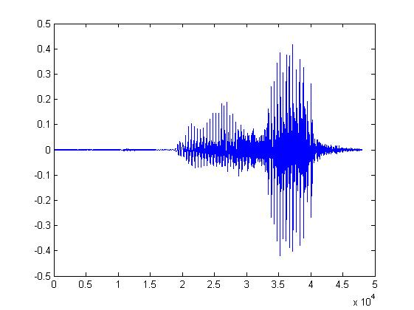
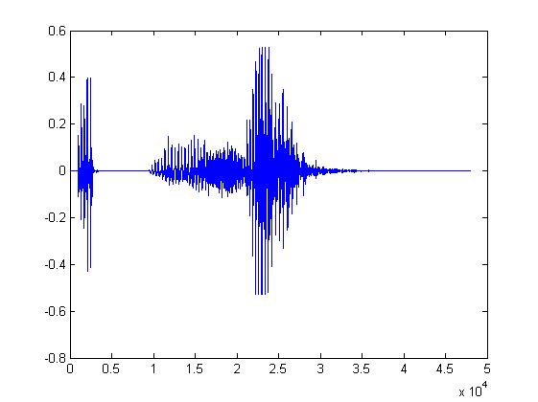
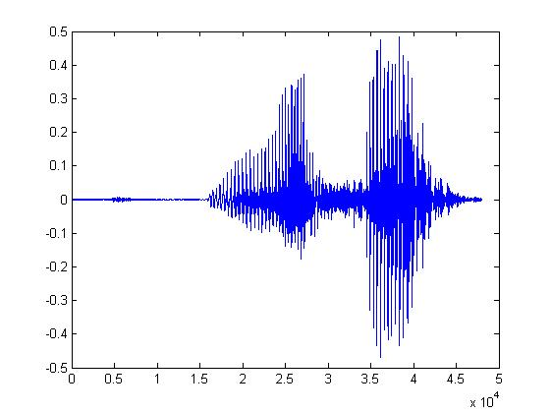
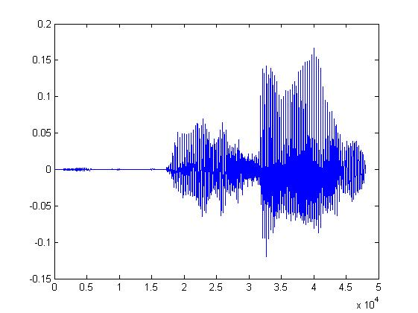
Some tasks are very complex
One day, you are asked to write a program for speech recognition.
Find the common patterns from the left waveforms.
你好
你好
You quickly get lost in the exceptions and special cases.
It seems impossible to write a program for speech recognition.
你好
你好
Notes:
還有很多同樣類型的問題，例如影像辨識
容易做到，卻無法描述

Slide 5


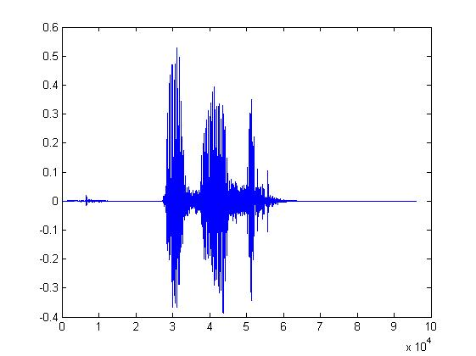
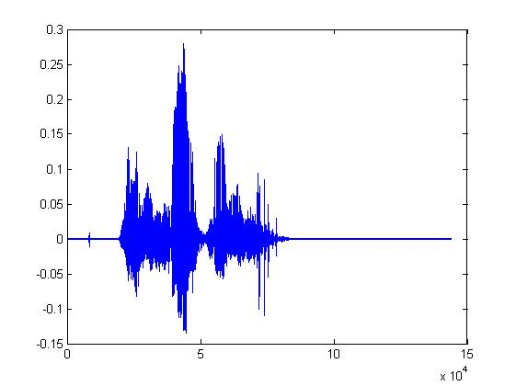
Let the machine learn by itself
Learning ......
你好
大家好
You said “你好”
人帥真好
You write the program for learning.
A large amount of audio data

Slide 6

Learning ≈ Looking for a Function
Speech Recognition
Handwritten Recognition
Weather forecast
Play video games
“你好”
“2”
weather today
“sunny tomorrow”
Positions and number of enemies
“fire”
Notes:
Function can be so complex

Slide 7

Framework
“你好”
“2”
Model
Hypothesis Function Set
label
大家好
“Best” Function
Training:
Pick the best Function f*
Testing:
Training
Data
function input
function output
Notes:
Repeat again

Slide 8
This Course
Machine Learning
Deep Learning
Structured Learning

Slide 9
Deep Learning

Slide 10
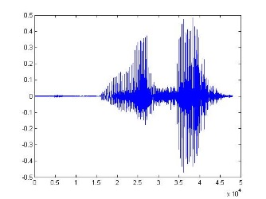
What is Deep Learning?
Model
Production line (生產線)
Hypothesis Functions
Simple
Function 1
Simple
Function 2
Simple
Function N
……
“Hello”
A very complex function
End-to-end training:
What each function should do is learned automatically
Notes:
It is hard to define deep learning.
生產線的概念

Slide 11
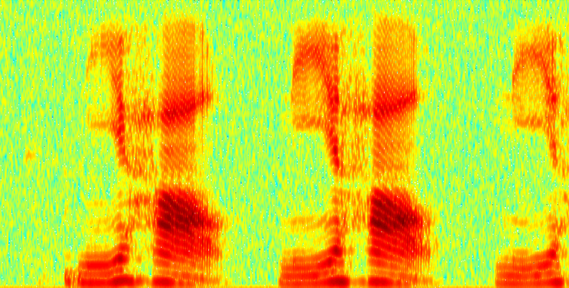
Deep v.s. Shallow - Speech Recognition
Shallow Approach
DFT
Waveform
spectrogram
GMM
DCT
log
…
“Hello”
Filter bank
MFCC
Each box is a simple function in the production line:
:hand-crafted
:learned from data
Notes:
Each box is a simple function in product line

Slide 12
Deep v.s. Shallow - Speech Recognition
“Bye bye, MFCC”
- Deng Li in Interspeech 2014
Deep Learning
f₁
f₂
All functions are learned from data
f₃
f₅
f₄
“Hello”
Less engineering labor, but machine learns more
Notes:
Same as in image and text
MFCC: Mel-frequency cepstral coefficients

Slide 13
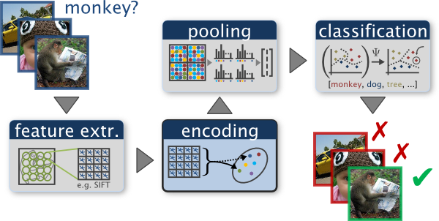
Deep v.s. Shallow - Image Recognition
Shallow Approach
http://www.robots.ox.ac.uk/~vgg/research/encoding_eval/
:hand-crafted
:learned from data
Notes:
Scale Invariant Feature Transform

Slide 14

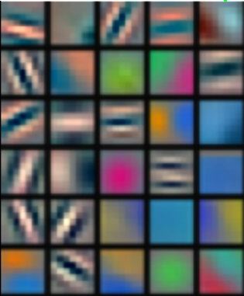
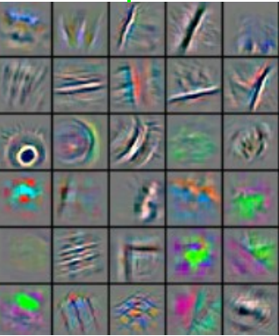
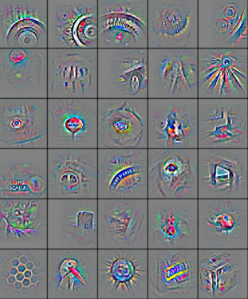
Deep v.s. Shallow - Image Recognition
Reference: Zeiler, M. D., & Fergus, R. (2014). Visualizing and understanding convolutional networks. In Computer Vision–ECCV 2014 (pp. 818-833)
Deep Learning
All functions are learned from data
f₁
f₂
f₃
f₄
“monkey”

Slide 15
What is Deep Learning?
Model
Production line
Deep learning usually referred to neural network based approach
Hypothesis Function Set
Simple
Function 1
Simple
Function 2
Simple
Function N
……
“Hello”
A very complex function
End-to-end training:
What each function should do is learned automatically
Notes:
It is hard to define deep learning.
生產線的概念

Slide 16
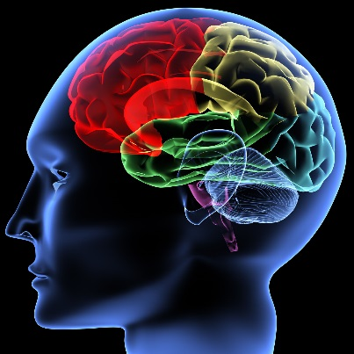
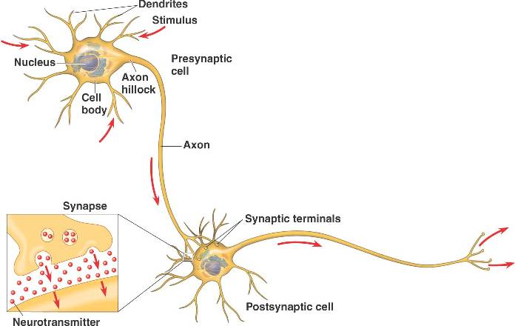
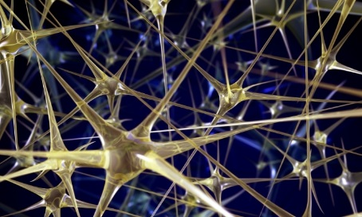
Inspired from Human Brains

Slide 17
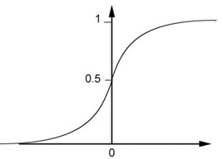
A Neuron for Machine
Each neuron is a very simple function
Activation function
…
Sigmoid function
bias

Slide 18
Deep Learning
A neural network is a complex function:
Cascading the neurons to form a neural network.
Each layer is a simple function in the production line.
Input
Layer 1
Layer 2
Layer L
Output
……
……
……
……
……
……
……
Hidden Layer
Notes:
Deep learning refers to deep neuron networks
For each neuron, the input can be input or hidden
Send information to next hidden or output
Given the input, how to compute the output

Slide 19
Ups and downs of Deep Learning
1960s: Perceptron (single layer neural network)
1969: Perceptron has limitation
1980s: Multi-layer perceptron
Do not have significant difference from DNN today
1986: Backpropagation
Usually more than 3 hidden layers is not helpful
1989: 1 hidden layer is “good enough”, why deep?
2006: RBM initialization (breakthrough)
2009: GPU
2011: Start to be popular in speech recognition
2012: win ILSVRC competition (image)
Notes:
They were popularised by Frank Rosenblatt in the early 1960’s.
In 1969, Minsky and Papert published a book called “Perceptrons” that analysed what they could do and showed their limitations.
The backpropagation algorithm was originally introduced in the 1970s, but its importance wasn't fully appreciated until a famous 1986 paper by David Rumelhart, Geoffrey Hinton, and Ronald Williams.
1989: http://deeplearning.cs.cmu.edu/notes/Sonia_Hornik.pdf
Speech: begin 2009
2012: Times

Slide 20
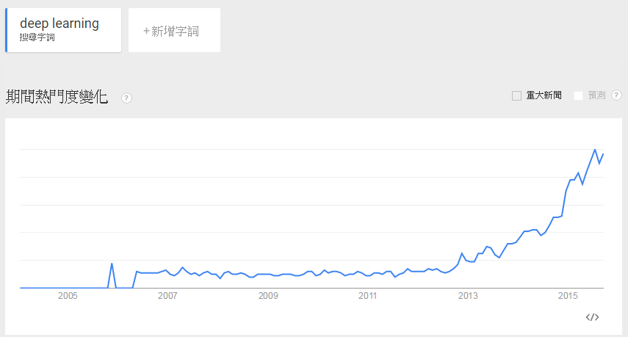
Become very Popular

Slide 21
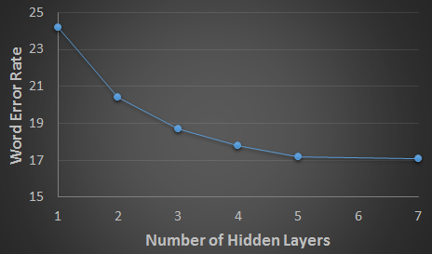
Why Deep Learning?
Deeper is Better.
Speech recognition
Seide, Frank, Gang Li, and Dong Yu. "Conversational Speech Transcription Using Context-Dependent Deep Neural Networks." Interspeech. 2011.
Notes:
SWB

Slide 22
Why Deeper is Better?
Deep works better simply because it uses more parameters.
……
……
……
……
……
Shallow
Deep

Slide 23
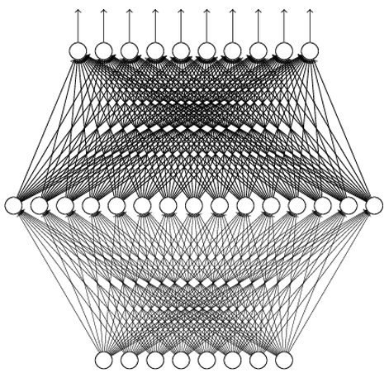
Universality Theorem
Any continuous function f
Can be realized by a network with one hidden layer
(given enough hidden neurons)
What is the reason to be deep?
Reference: http://neuralnetworksanddeeplearning.com/chap4.html
Why “Deep” neural network not “Fat” neural network?
Notes:
SVM

Slide 24
Fat + Short v.s. Thin + Tall
If they have the same parameters,
Which one is better?
……
……
……
Shallow
Deep

Slide 25
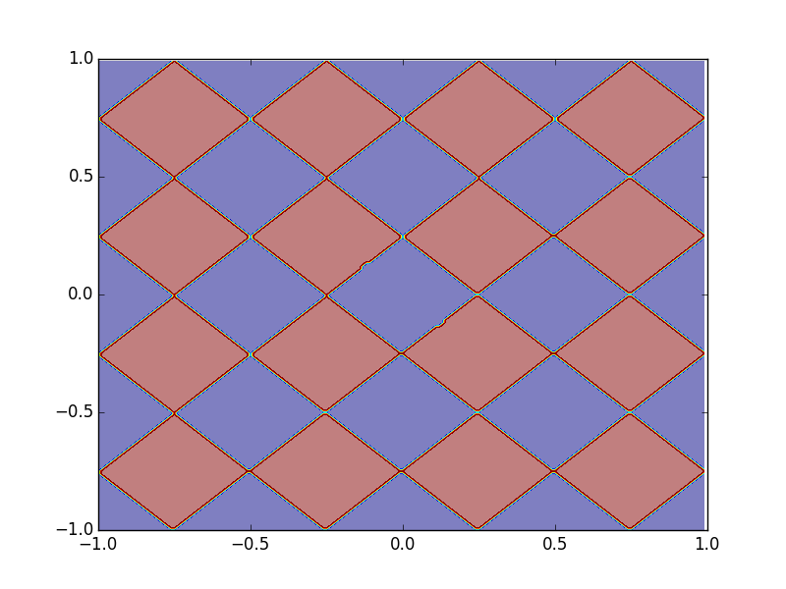
Fat + Short v.s. Thin + Tall Toy Example
Sample 10,0000 points as training data
1
0
……
……
0 or 1
……
……
……
……

Slide 26
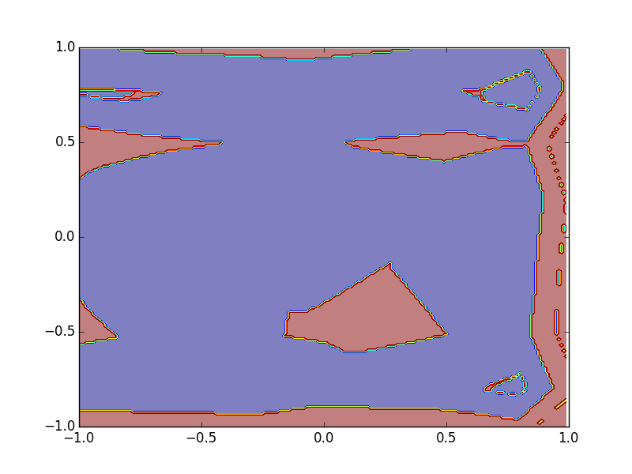
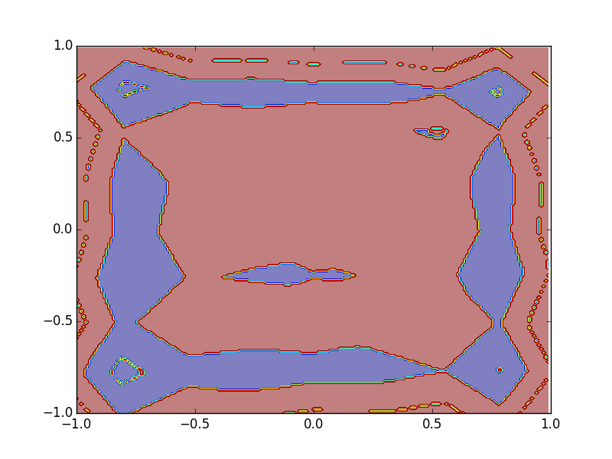
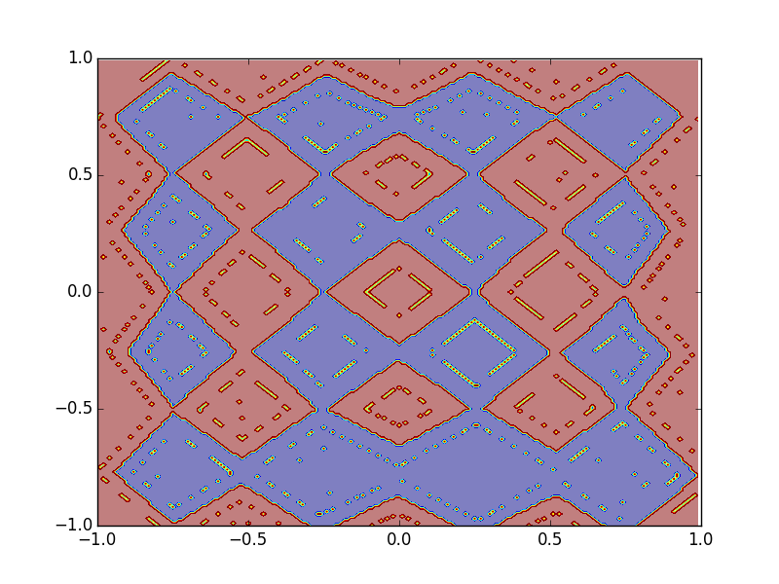
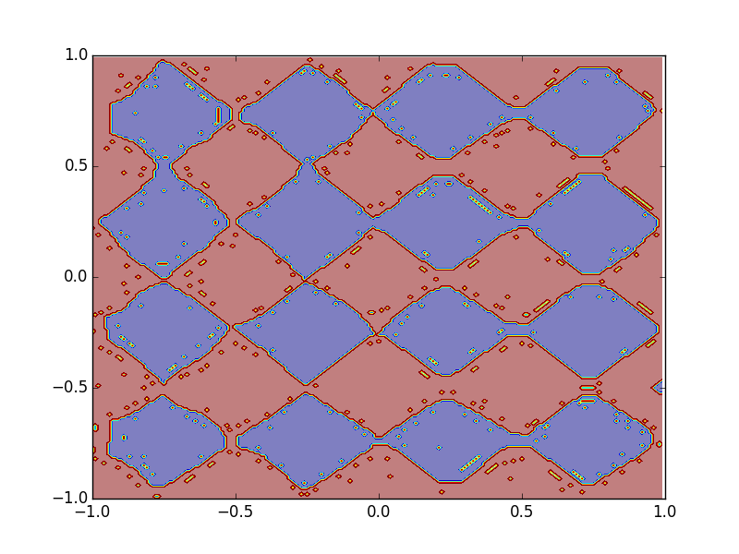
Fat + Short v.s. Thin + Tall Toy Example
1 hidden layer:
(A) 125 neurons
(B) 500 neurons
(C) 2500 neurons
3 hidden layers:
Q: the number of parameters close to (A), (B) or (C)?
Notes:
14 * 3 = 42

Slide 27
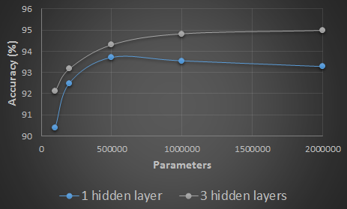
Fat + Short v.s. Thin + Tall Hand-writing digit classification
Same parameters
Deeper: Using less parameters to achieve the same performance

Slide 28
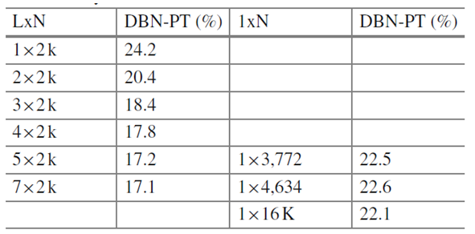
Fat + Short v.s. Thin + Tall Speech Recognition
Word error rate (WER)
Multiple layers
1 hidden layer
Seide, Frank, Gang Li, and Dong Yu. "Conversational Speech Transcription Using Context-Dependent Deep Neural Networks." Interspeech. 2011.
Notes:
SWB
For a fixed number of parameters, a deep model is clearly better than the shallow one.

Slide 29
Think about Logic Circuits ……
A two-layer circuit of logic gates can represent any Boolean function.
Using multiple layers of logic gates to build some functions are much simpler (less gates needed).
E.g. parity check
Circuit
1 0 1 0
1 (even)
For input sequence with d bits,
Circuit
Two-layer circuit need O(2^{d}) gates.
0 0 0 1
0 (odd)
Notes:
Any Boolean function can be written as a sum of products (disjunctive normal form: AND gates on the first layer with optional negation of inputs, and OR gate on the second layer) or a product of sums (conjunctive normal form: OR gates on the first layer with optional negation of inputs, and AND gate on the second layer).
同位元檢查(Parity Check)
00 1
01 0
10 0
11 1

Slide 30
Think about Logic Circuits ……
A two-layer circuit of logic gates can represent any Boolean function.
Using multiple layers of logic gates to build some functions are much simpler (less gates needed).
E.g. parity check
XOR
1
0
0
1
0
1
0
With multiple layers, we need only O(d) gates.
Notes:
Any Boolean function can be written as a sum of products (disjunctive normal form: AND gates on the first layer with optional negation of inputs, and OR gate on the second layer) or a product of sums (conjunctive normal form: OR gates on the first layer with optional negation of inputs, and AND gate on the second layer).
同位元檢查(Parity Check)
00 1
01 0
10 0
11 1

Slide 31
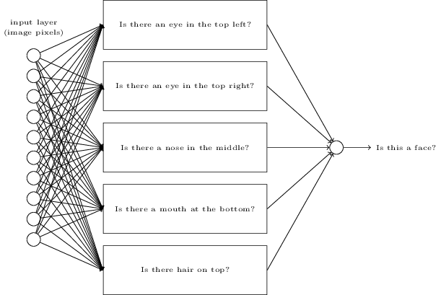
Back to Deep Learning
Some functions can be easily represented by deep structure
Perhaps the functions that can be naturally decomposed into several steps
E.g. image
http://neuralnetworksanddeeplearning.com/chap1.html

Slide 32
Back to Deep Learning
Some functions can be easily represented by deep structure
Perhaps the functions that can be naturally decomposed into several steps
E.g. image
To represent the functions with shallow structure needs much more parameters
More parameters imply more training data needed
To achieve the same performance, deep learning needs less training data
With the same amount of data, deep learning can achieve better performance.

Slide 33
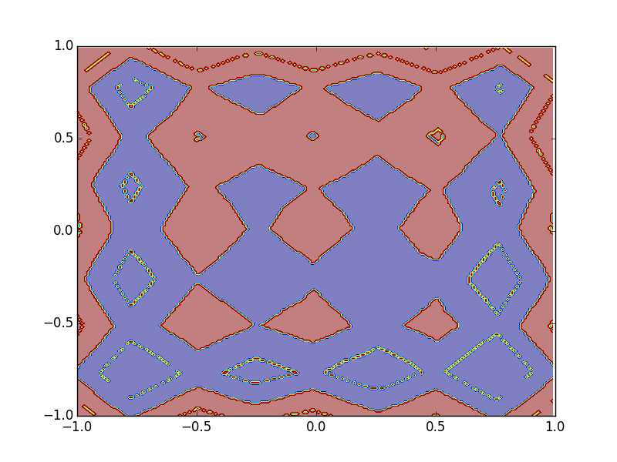
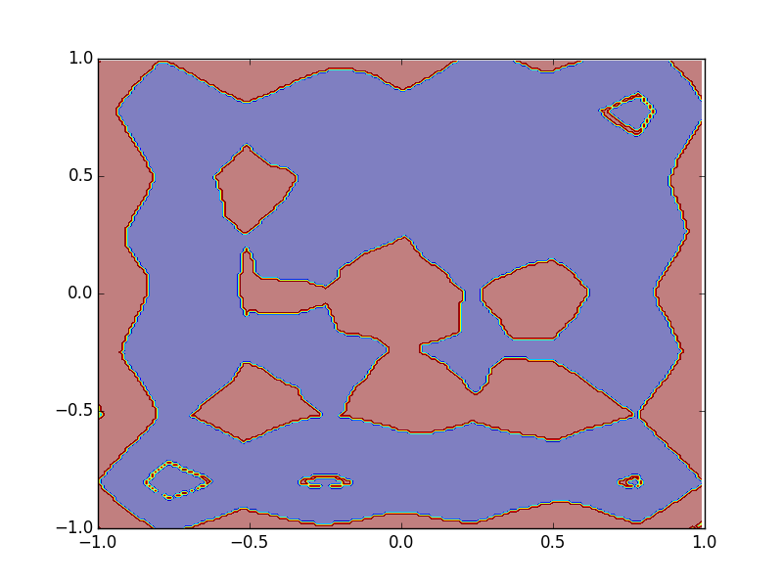
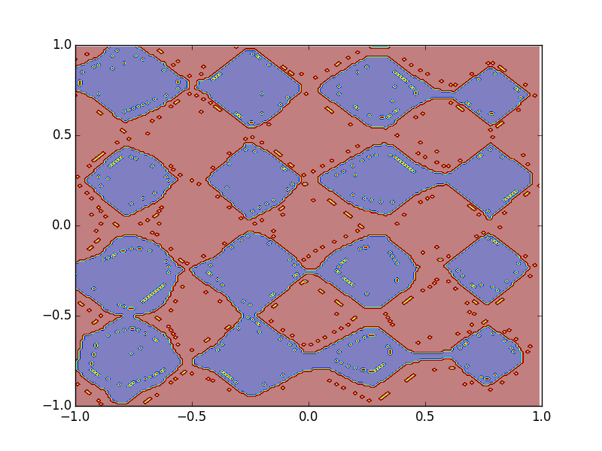
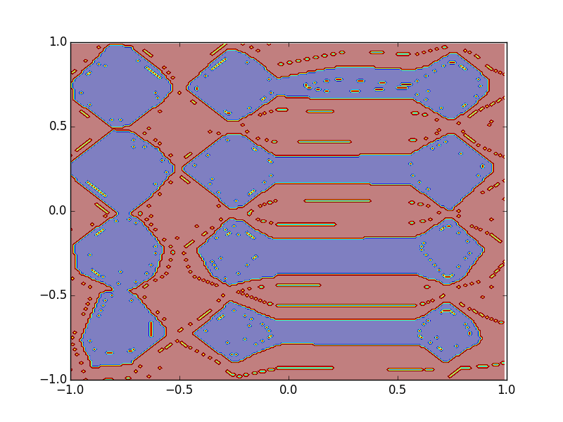
Size of Training Data
Different numbers of training examples
10,0000
5,0000
2,0000
1 hidden
layer
More parameters
3 hidden
layers
Less parameters

Slide 34
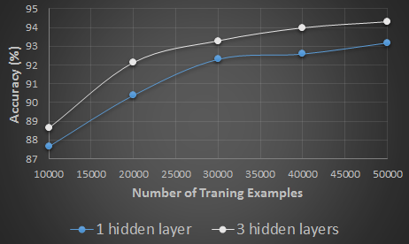
Size of Training Data
Hand-writing digit classification
Deeper: Using less training data to achieve the same performance
Notes:
100k

Slide 35
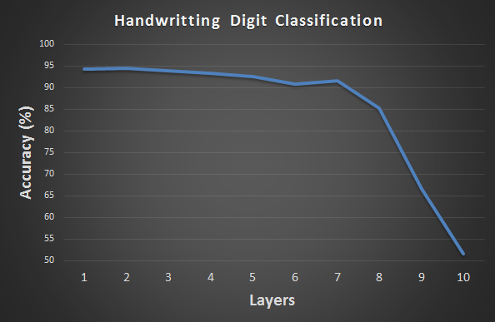
Why deep is not popular before?
In the past, usually deep does not work ……
?
We will go back to this issue in the following lectures.

Slide 36
What is Structured Learning?

Slide 37
In the real world ……
X (Input domain):
Sequence, graph structure, tree structure ……
Y (Output domain):
Sequence, graph structure, tree structure ……
Notes:
Just name a few
Take human language processing and image processing as examples

Slide 38

Retrieval
“Machine learning”
(keyword)
A list of web pages (Search Result)

Slide 39
Translation
“Machine learning and having it deep and structured”
“機器學習及其深層與結構化”
(One kind of sequence)
(Another kind of sequence)
Notes:
課程名稱只能有12 個字

Slide 40
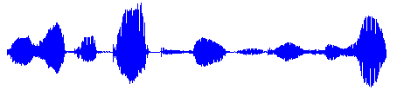
Speech Recognition
“大家好，歡迎大家來修機器學習及其深層與結構化”
(One kind of sequence)
(Another kind of sequence)
Notes:
How we use deep learning in speech recognition?

Slide 41
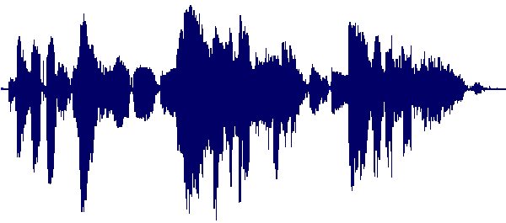
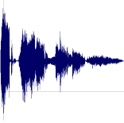
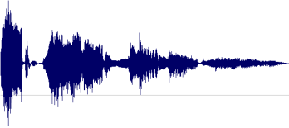
Speech Summarization
Record Lectures
Select the most informative segments to form a compact version
Summary

Slide 42

Object Detection
Image
Object Positions
Haruhi
Mikuru

Slide 43
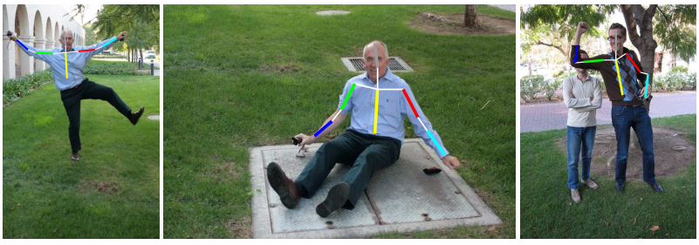
Pose Estimation
Image
Pose
Source of images: http://groups.inf.ed.ac.uk/calvin/Publications/eichner-techreport10.pdf
Notes:
Application?

Slide 44
Concluding Remarks
Machine Learning
Deep Learning
Structured Learning
Notes:
Deep learning is method
Structured learning is problem

Slide 45
Reference
No Textbook
Deep Learning
“Neural Networks and Deep Learning”
written by Michael Nielsen
http://neuralnetworksanddeeplearning.com/
“Deep Learning” (not finished yet)
Written by Yoshua Bengio, Ian J. Goodfellow and Aaron Courville
http://www.iro.umontreal.ca/~bengioy/dlbook/
Structured Learning
No suggested reference

Slide 46
Thank you!

Slide 47
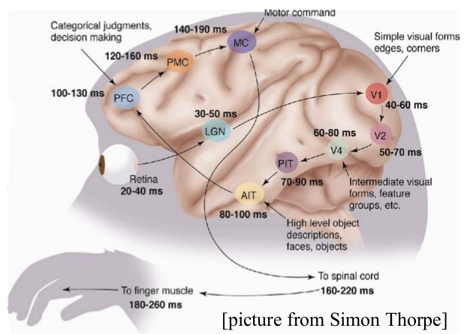
Human Brains are Deep
Notes:
In each hemisphere of our brain, humans have a primary visual cortex, also known as V1, containing 140 million neurons, with tens of billions of connections between them. And yet human vision involves not just V1, but an entire series of visual cortices - V2, V3, V4, and V5 - doing progressively more complex image processing. We carry in our heads a supercomputer, tuned by evolution over hundreds of millions of years, and superbly adapted to understand the visual world. Recognizing handwritten digits isn't easy. Rather, we humans are stupendously, astoundingly good at making sense of what our eyes show us. But nearly all that work is done unconsciously. And so we don't usually appreciate how tough a problem our visual systems solve.

